Slide 1
Division of Educator Investigations Fingerprinting & the Do Not Hire Registry Region 1 Education Service Center August 4, 2020

Slide 2
Agenda for Today
Do Not Hire Registry
Misconduct Reporting Portal
Reporting Requirements
Fingerprinting Overview
Questions
Notes:
SPEAKER : Laura and David

Slide 3
Do Not Hire Registry

Slide 4
HB3– 86th
HB 3 (Article 2A) was passed to further protect the safety and welfare of Texas students by:
Requiring schools to report certain allegations of misconduct against non-certified employees and,
Creating a Registry of individuals who are not eligible for hire in a Texas public school based on misconduct or criminal history.

Slide 5
Who Is on the Registry?
Individuals who had an SBEC certificate revoked who
Abused a student or minor; or
Involved in a romantic relationship with or solicited / engaged in sexual contact with a student or minor
Non-certified employees who were found to have:
Abused a student or minor; or
Involved in a romantic relationship with or solicited / engaged in sexual contact with a student or minor
Individuals with criminal history
Placed on the sex offender registry after receiving deferred adjudication or being convicted; or
Convicted of a Title V offense where the victim was under 18
Certain offenses for charter school employees - “Would they be denied certification?”

Slide 6
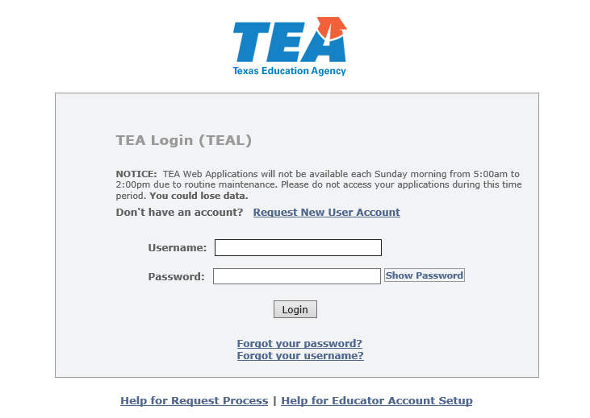
Registry of Persons Not Eligible for Employment
Secure View
Application in TEAL
Accessed by authorized school staff
Schools can see identifying information (SSN, DOB, etc.) and should hire accordingly
Accessed by TEA Educator Investigations
Released January 2020

Slide 7
Frequently Asked Questions (FAQ)
Question
Can the public see who is on the Registry?
Answer
TEA created a webpage where members of the public can search the Registry by name. However, privacy laws prevent the agency from publishing SSNs or DOBs accessible by the public. Therefore, members of the public can only see the name and status (“under investigation” or “ineligible for hire”) of any individual on the Registry.
Public schools and private schools, who are given access to the confidential portal, can view personal identifiers to confirm an individual’s identity. These schools are able to upload and search names in bulk.
Notes:
Members of the public can obtain additional information by
-PIR
-Similar to the virtual certificate that currently exists for SBEC certificate holders

Slide 8
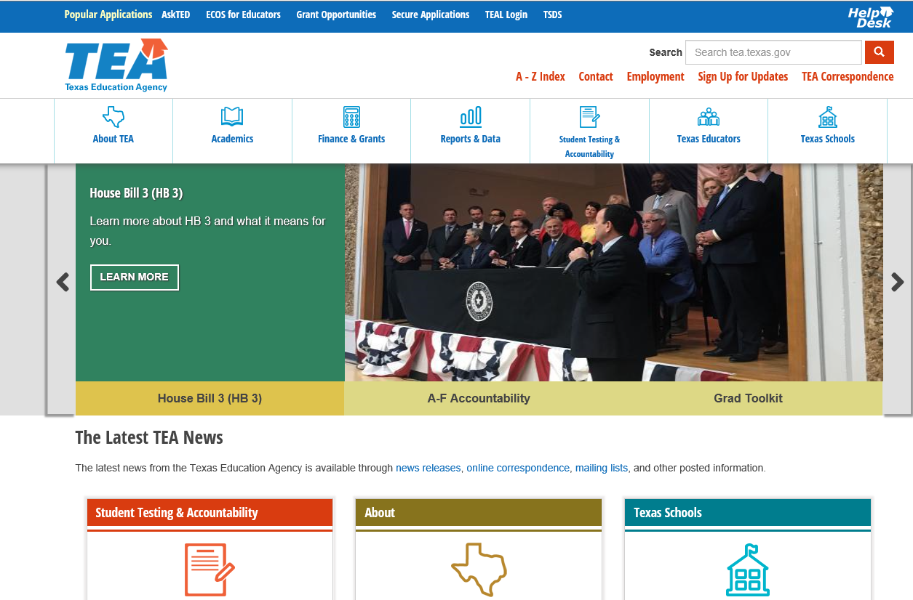
Registry of Persons Not Eligible for Employment
Public View:
On TEA website, like the Virtual Certificate Look up
Display
First Name, Last Name
Approximate age
Date on Registry
Registry Status
Does not display personal identifiers
Released April 2020

Slide 9
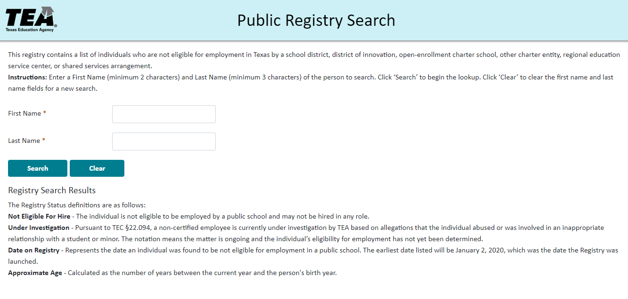
Public Registry Search

Slide 10
What does this mean for public schools?
Create a procedure for investigating and reporting allegations against non-certified employees
Check the Registry before hiring employees
Terminate the employment of anyone on the Registry
Create a procedure for periodically checking all employees against the Registry
TEA will periodically review school records to verify compliance
Non-compliance is violation of charter or termination of DOI status
In Statute
Registry of persons not eligible for employment in public schools - TEC §22.092 as created by HB 3, Individuals not eligible for employment - TEC §22.0832, §22.0833, §22.085 and §21.058(b)

Slide 11
Questions
Notes:
SPEAKER : Laura

Slide 12
Accessing the Registry

Slide 13
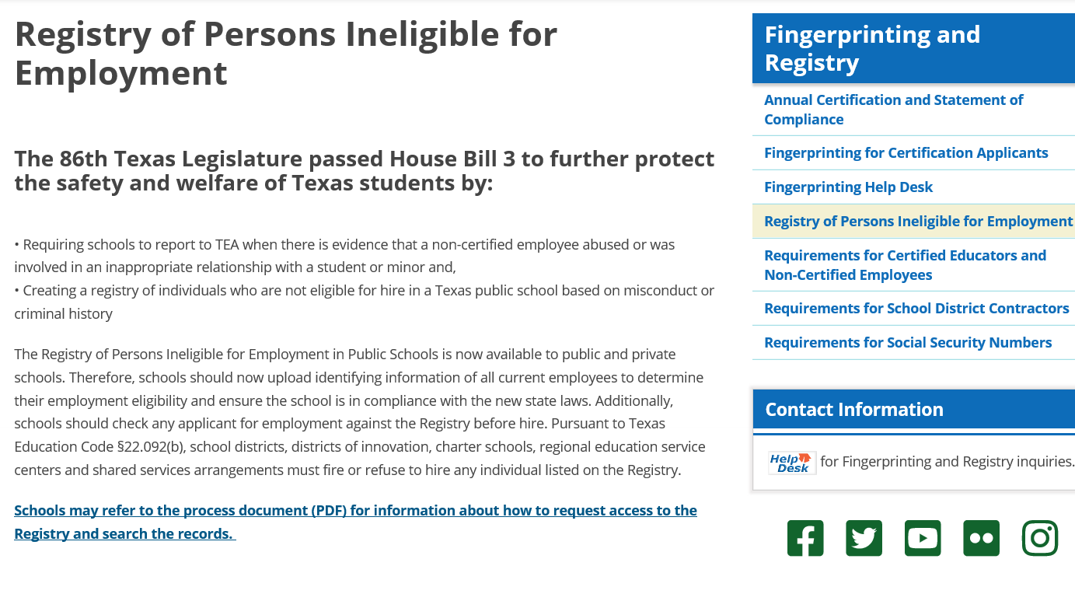
Quick Demo: Process Guide
Detailed guide

Slide 14
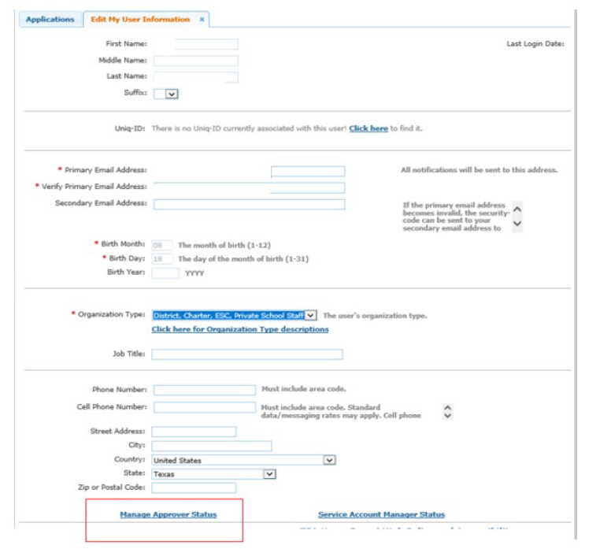
Quick Demo: Obtain TEAL Access
Request a TEAL Account (if you don’t already have one)
Your access request must be approved by your district’s primary approver and by TEA

Slide 15
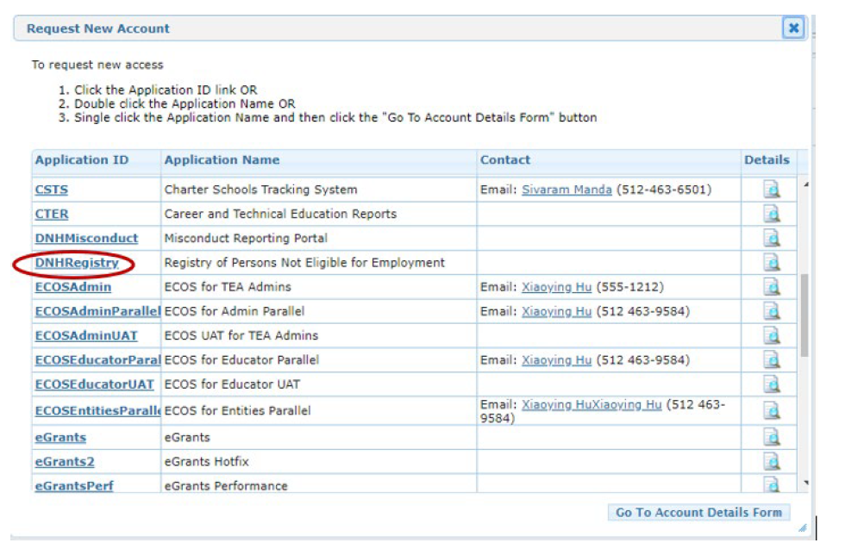
Quick Demo: Obtain Registry Access
In TEAL, go to My Application Accounts > Request New Accounts
Select “DNHRegistry”
Select your Organization

Slide 16
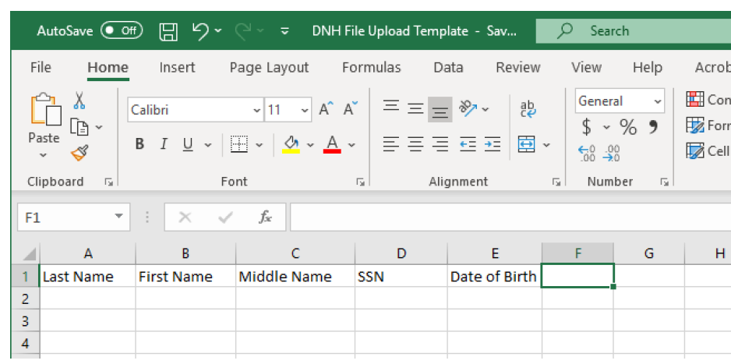
Quick Demo: Create Upload File to Search
Create a file with the names that you want to search
If needed, a template is available on the TEAL/Registry page
Search < 2,500 names at one time

Slide 17
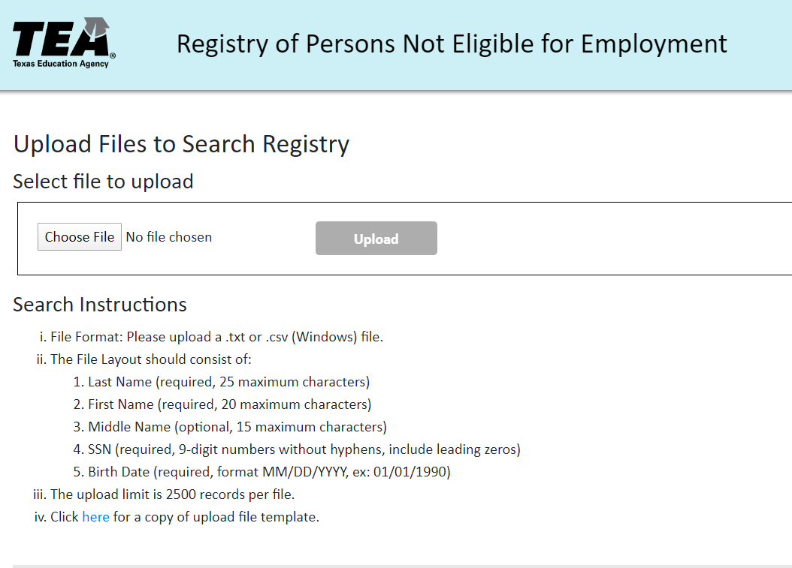
Quick Demo: Upload File and Receive Results
Once you create the CSV, upload the file to search the system
System will return a Result File and record the search on your organization’s results page

Slide 18
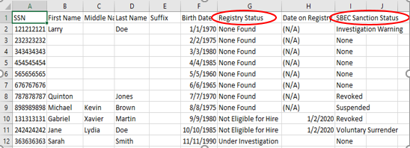
Quick Demo: View the Results File
Open the file and view the results
Registry status will be
None Found
Under Investigation
Not Eligible for Hire
SBEC sanctions displayed

Slide 19
How does the Registry system relate to the Fingerprinting System?

Slide 20
Comparing Systems
 | Do Not Hire Registry – School Upload | Fingerprinting Upload (ECOS Green Screen)
Registry Status
SBEC Investigation / Sanction Status
Fingerprinting Status
Pre-Enroll Individual (Begin FP Process)
Available to Texas Private Schools

Slide 21
Questions
Notes:
SPEAKER : Laura

Slide 22
Misconduct Reporting Portal

Slide 23
Misconduct Reporting Portal
Application in TEAL; Accessed by authorized school staff and TEA Educator Investigations
Most secure and expedient method for sending reports of educator misconduct.
Reports received through the portal are processed through Intake/Review Unit
Handoff between school district and Ed Inv

Slide 24
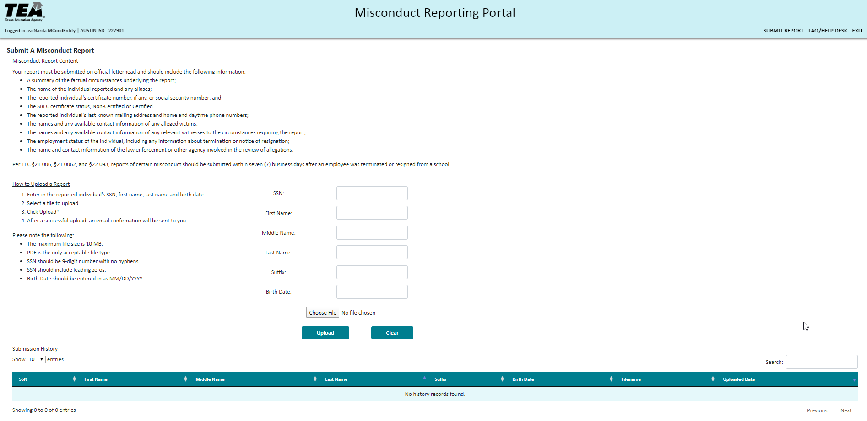
Misconduct Reporting Portal
Question
Your report must include the following information:
A summary of the factual circumstances underlying the report;
The name of the individual reported and any aliases;
The reported individual's certificate number, if any, or social security number and date of birth;
The reported individual's last known mailing address and home and daytime phone numbers;
The names and any available contact information of any alleged victims;
The names and any available contact information of any relevant witnesses to the circumstances requiring the report;
The employment status of the individual, including any information about termination or notice of resignation;
The name and contact information of the law enforcement or other agency involved in the review of allegations.
24

Slide 25
How to Submit a Report
How to submit a report:
Enter the reported individual’s SSN, first name, last name and date of birth
Select a file to upload
Click ‘Upload’
After a successful upload, an email confirmation will be sent to you
Please note:
Maximum file size is 10MB
PDF and jpeg files can be uploaded
Enter 9 digit SSN with no hyphens
Birth date should be entered MM/DD/YYY
Question
25

Slide 26
Advantages of using the
Misconduct Reporting Portal
Ease of Use/Accessibility
-Portal outlines the required information needed
-No need to change current structure of reports
Confirmation Email Generated Upon Submission
Cost Effective & Efficient
-Alleviates cost of postage/certified mail
-Reports received in real time by TEA

Slide 27
Frequently Asked Question
Where should schools send reports of misconduct?
Question
Answer
The law now requires some reports of misconduct to be submitted to the Commissioner and others to be reported to the SBEC. To simplify the reporting process, schools should send all reports to the TEA Division of Educator Investigations. Reports can be sent by mail, fax, or through the Internet portal. The division’s contact information can be found on the TEA website. Please do not submit reports through email.
Key Takeaway
The internet reporting portal serves as the most confidential and expedient method for sending reports. Additionally, the portal creates a digital record to prove that a school sent the information.
27

Slide 28
Questions
Notes:
SPEAKER : Laura

Slide 29
Reporting Requirements and School Obligations

Slide 30
Public School Reporting Requirements
 | Certified Educators | Non-certified Educators and Employees
What to report: | Abused or otherwise committed an unlawful act with a student or minor Was involved in a romantic relationship with or solicited or engaged in sexual contact with a student or minor
 | Possessed, transferred, sold, or distributed a controlled substance Illegally transferred, appropriated, or expended school funds or property Attempted by fraudulent means to obtain or alter any certificate to gain employment or additional compensation Committed a criminal offense on school property or at a school-sponsored event

Slide 31
Public School Reporting Requirements
 | Certified Educators | Non-certified Educators and Employees
Principal requirement: | Report to Superintendent within 7 business days of learning that an individual was terminated or resigned
Superintendent requirement: | Report to TEA within 7 business days of learning that an individual was terminated or resigned By mail, fax, or internet reporting portal (when launched). Do not submit through email.
In Statute
Required reporting of allegations against SBEC certificate holders - TEC §21.006 / TAC §249.14, Exception to reporting requirement - TEC §21.006(b),(c), and (c-2) as amended by SB 1476, Required reporting of allegations against non-certified employees - TEC §22.093 as added by HB3, Internet portal - TEC §22.095

Slide 32
Public School Reporting Requirements
 | Certified Educators | Non-certified Educators and Employees
School investigation: | Required to complete, despite employee resignation
Exception to requirement: | Not required to report if school investigation determines educator did not abuse or engage in inappropriate relationship | None. However, all reports will be reviewed upon receipt to determine if a TEA investigation is justified
Penalty for non-reporting: | SBEC sanctions Criminal offense if intent to conceal Admin penalty (fines) | SBEC sanctions Criminal offense if intent to conceal
In Statute
Required reporting of allegations against SBEC certificate holders - TEC §21.006 / TAC §249.14, Exception to reporting requirement - TEC §21.006(b),(c), and (c-2) as amended by SB 1476, Required reporting of allegations against non-certified employees - TEC §22.093 as added by HB3, Internet portal - TEC §22.095

Slide 33
Questions
Notes:
SPEAKER : Laura

Slide 34
Fingerprinting

Slide 35
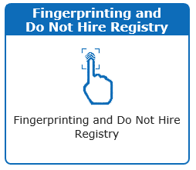
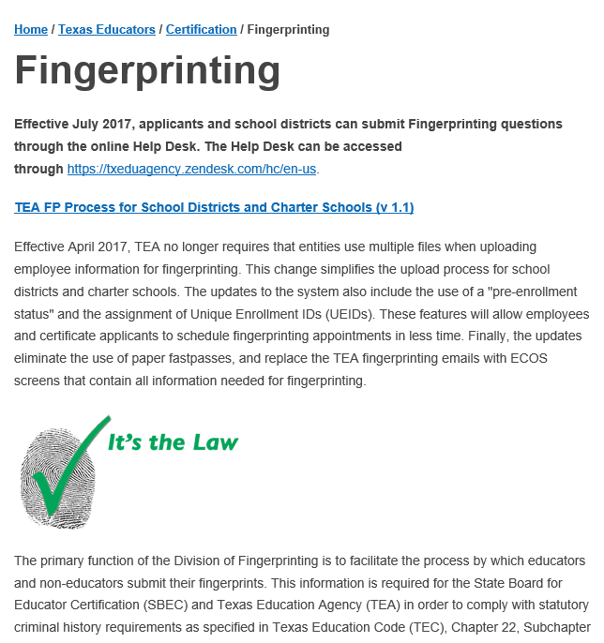
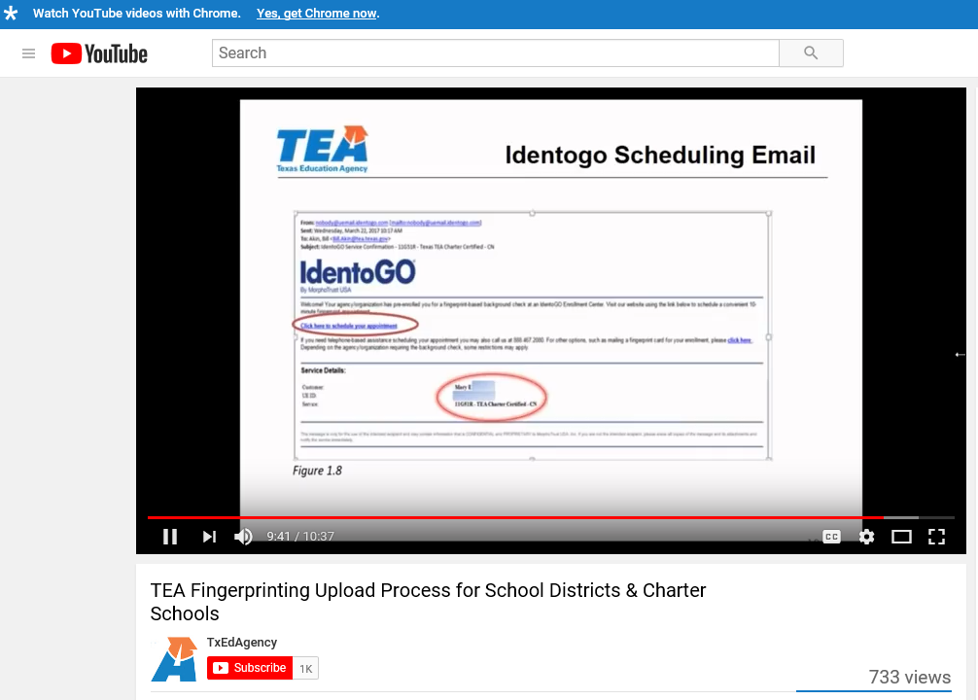
Contact the Fingerprinting and Registry Support Unit
Provide training and customer support for processes involving:
SBEC certificate applicant fingerprinting
Public-school employee fingerprinting
Compliance with the Do Not Hire Registry (HB3)
Develop resources for applicants, schools, and ESCs
Phone Support
Website
Process Documents
Training Videos

Slide 36
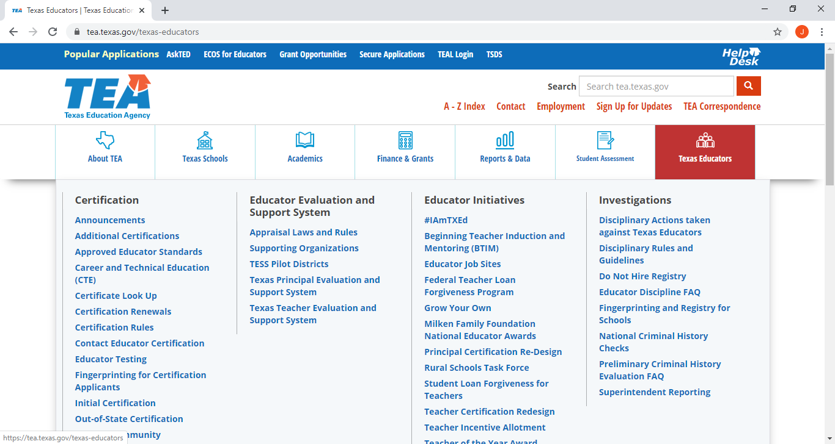
Fingerprinting

Slide 37
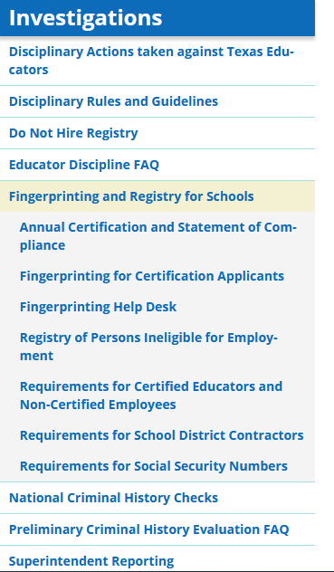
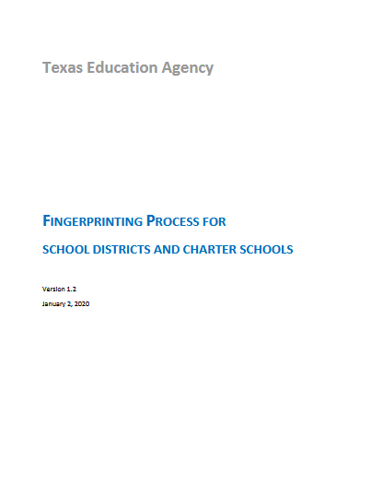
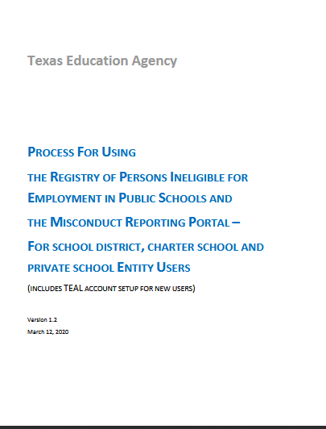
Fingerprinting & Registry Resources

Slide 38
Fingerprinting Overview
Who must print
SBEC certificate holders
Applicants for certificate
Non-Certified employees
Substitutes
Contractors*
In Statute: Applicants for Certification and Certificate Holders - TEC §22.0831, Non-Certified Employees - TEC §22.0833, Charter School Employees - TEC §22.0832, *Contractors - TEC §22.0834, Texas Government Code 411.0845

Slide 39
Fingerprinting: Contractors
Between school and contractor
Contractors must certify compliance to the school
School may request additional information to verify
Access to fingerprinting – FBI Audit

Slide 40
Fingerprinting: Steps to Compliance
Obtain access to TEA and DPS databases
Upload employees
Ensure employees fingerprint
Review criminal history (and subsequent hits)
Superintendent certifies compliance annually
Subscribe “To The Administrator Addressed” listserv

Slide 41
Fingerprinting for Other Purposes
Prior fingerprinting for other agencies cannot be transferred to TEA/SBEC.

Slide 42
Out-of-State Applicants
Applicants may be printed at approved out-of-state IdentoGO locations; additional fees will be charged
Out-of-state educators may still utilize the card process at this time

Slide 43
Annual Compliance Certification
Each year, superintendents and chief operating officers are required to certify to TEA that school has complied with fingerprinting laws
Posted to the TEA website in October each year
School placed on TEA website for non-compliance

Slide 44
Questions
Notes:
SPEAKER : Laura

Slide 45
Fingerprinting Easy Solutions for Common Problems

Slide 46
Correcting Errors on Uploads
When incorrect information is uploaded for fingerprinting, DO NOT re-upload to correct information - This will not correct the error
Errors that may need correcting are names, Dates of Birth, Email address, and SSNs
Upload errors can only be corrected by submitting a ticket through the Help Desk or by contacting us by phone

Slide 47
Re-sending IdentoGo Emails
When an individual has been uploaded, and the scheduling email has not been received, please do the following BEFORE contacting TEA…
Have the individual search for ‘IdentoGo’ in their email
Check the Upload Results screen
Individual may be FP Complete
Individual may be Certified
If status is Pre-enrolled, check ‘Non-Certified’ screen for UEID to schedule appointment

Slide 48
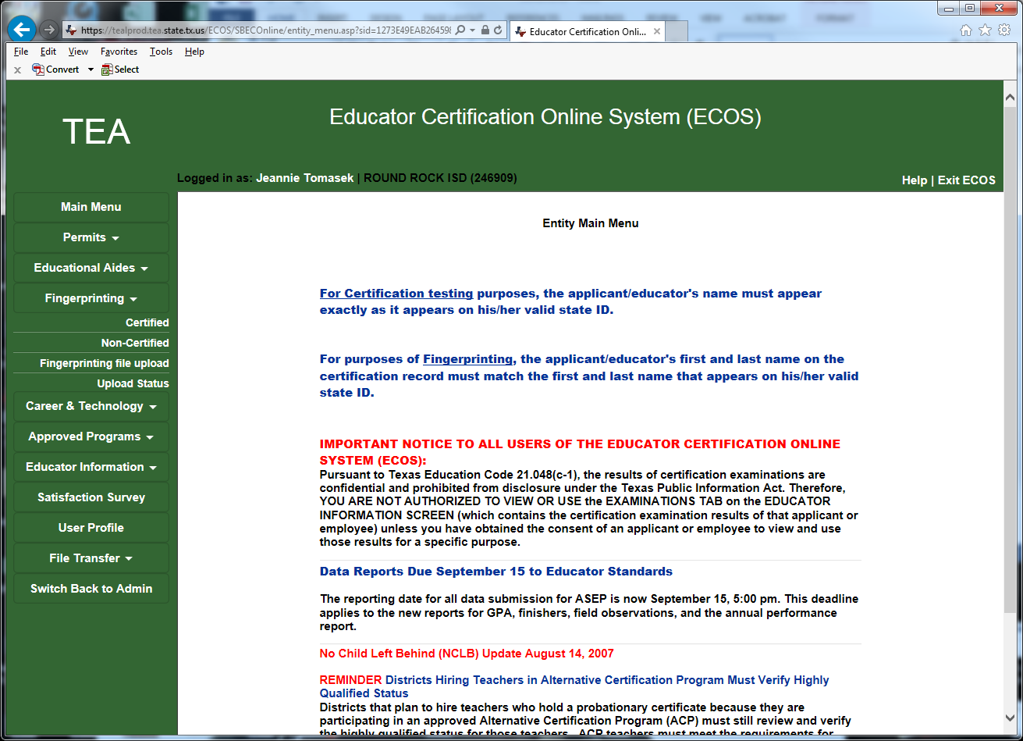
Checking Upload Status

Slide 49
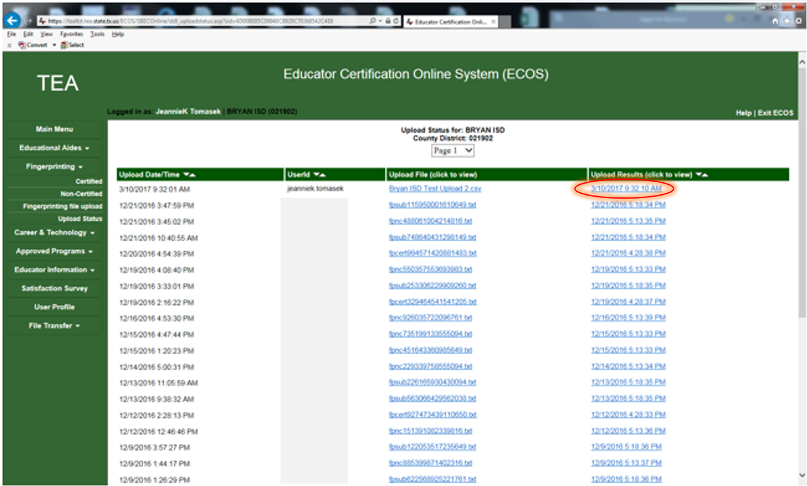
Accessing Upload Results

Slide 50
Reviewing Upload Results

Slide 51
Fingerprint Statuses
FP Complete - An individual has completed the fingerprint process.
Pre-enrolled - An individual is pre-enrolled with the fingerprinting vendor and should schedule an appointment to be fingerprinted.
FP Needed - A certified educator must submit fingerprinting payment in ECOS to initiate pre-enrollment and then schedule an appointment to be fingerprinted. A non-certified employee has uploaded previously by another district and TEA must manually sen a new pre-enrollment.
Contact TEA - Contact the TEA Fingerprinting Unit at 512-936-8400, Option 3 for assistance.

Slide 52
Questions
Notes:
SPEAKER : Laura

Slide 53
Agency Guidance around COVID-19 Limitations

Slide 54
COVID-19 Support

Slide 55
Frequently Asked Questions (FAQ)
Question
Will there be any leeway for fingerprinting of teacher candidates or other employees who will not be able to go in for digital fingerprinting at this time?
Answer
The Tx DPS fingerprinting vendor has closed or reduced operating hours in nearly half of its locations in Texas due to the COVID-19 pandemic. The closures have resulted in some decrease in fingerprinting appointment availability within certain regions. However, in the interest of student safety, TEA is not planning to modify fingerprinting requirements for certificate applicants, non-certified employees, or any other individuals required to fingerprint for TEA or SBEC.
Fingerprinting is required only for issuance of the initial certificate. Therefore, an individual does not need to fingerprint again to receive additional certificates. Furthermore, if an individual previously fingerprinted as a non-certified school district or charter school employee, the person does not need to fingerprint again.
Notes:
Members of the public can obtain additional information by
-PIR
-Similar to the virtual certificate that currently exists for SBEC certificate holders

Slide 56
Frequently Asked Questions (FAQ)
Question
Will applicants for SBEC certification or employment at a school district be allowed to wear masks during their fingerprinting appointment?
Answer
An applicant may wear a mask through most of the fingerprinting appointment. However, the Tx DPS has advised that applicants will be required to take a photograph without a mask. Therefore, if an applicant is unwilling to remove their mask for the photo-portion of the appointment, the process will stop, and the applicant will be asked to reschedule for a later date.
Tx DPS has requested that the fingerprinting vendor adhere to recommended practices for the sanitization of workstations and public areas, maintain a 6' distance between people when possible, and that fingerprinting agents use any available personal protective equipment (PPE). DPS has also posted a list of guidelines to reduce the likelihood of exposure during the fingerprinting appointment. That list can be found here: https://secure.txdps.state.tx.us/clearinghouse/.
Notes:
Members of the public can obtain additional information by
-PIR
-Similar to the virtual certificate that currently exists for SBEC certificate holders

Slide 57
Jeannie Tomasek, Program Supervisor
Anna Amaro, FP & Registry Support Specialist
Ashley Pillay, FP & Registry Support Specialist
Shaun Thompson, Intake & Review Specialist
David Rodriguez, Director Educator Investigations
QUESTIONS

